Slide 1







AUTOLUMINA
A smart vehicle L ght control solution
APP ID: IC2023-290
TEAM MEMBERS :
ALEXANDAR HARIHARAN.S | VIGHNESHWARA.B
DHIVAKAR.K | KOGUL.S

Slide 2









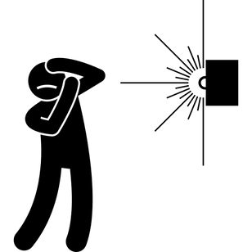



PROBLEMS
POOR VISIBILITY AND DISTRACTION
NIGHT TIME DRIVING BECOMES CONSIDERABLY CHALLENGING DUE TO GLARE.
OCCURENCE OF HIGH NIGHT TIME ACCIDENTS

Slide 3
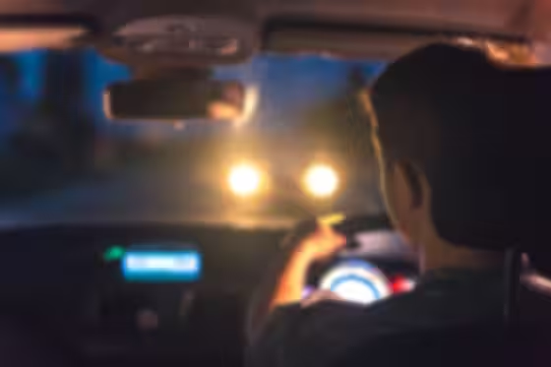

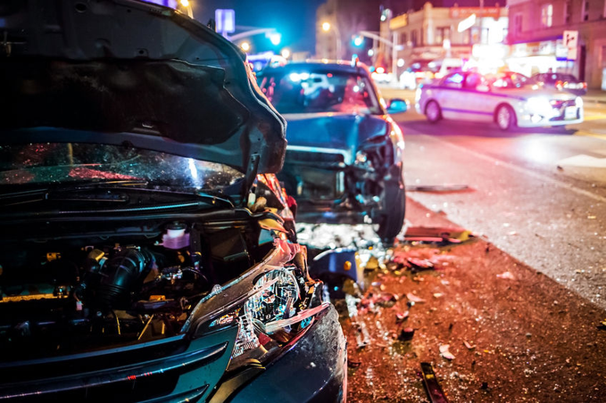


CASE STUDY
As per the NHTSA about glare perception, 30% find the glare from oncoming headlights disturbing.
Around 50% of fatal crashes occur at night. Headlight glare is barely considered one of the hazardous actions or causes that lead to fatal car accidents.
Source: theclarklawoffice.com

Slide 4






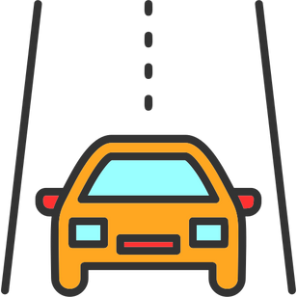


SOLUTIONS
AUTOMATIC HEADLIGHT ADJUSTMENT
ANTI-GLARE SYSTEM
COMFORT DRIVING
SAFER RIDING AT NIGHTTIME

Slide 5

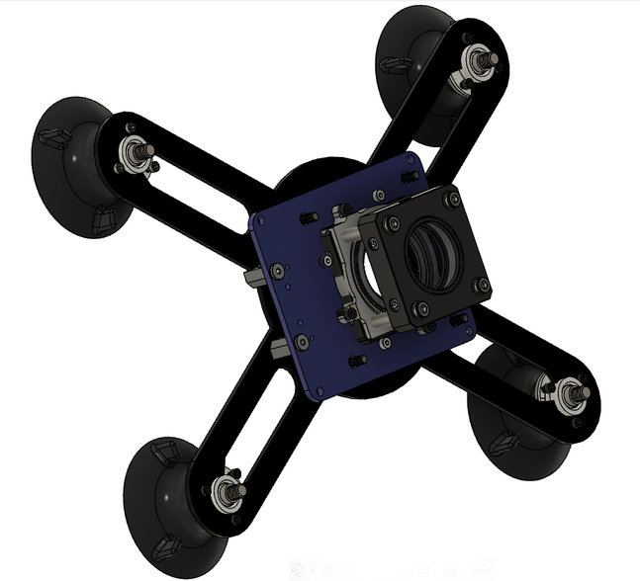

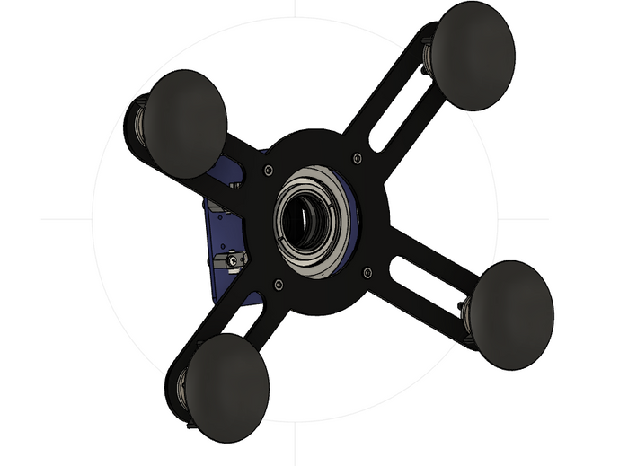


WHAT WE GIVE OUT?
DEVELOPED MODEL
The primary objective of this project is to revolutionize road safety during nighttime driving by effectively countering the challenges presented by headlight glare.
This dynamic adaptation is activated when the vehicle reaches a constant speed of above 50km/hrs on highways.
TECHNOLOGY
ACHIEVEMENTS
POLARIZED FILTERS
REDUCES GLARE FROM ONCOMING VEHICLES
PIEZOELECTRIC MOTOR
ROTATES THE POLARIZER IN REAL-TIME
LIDAR TECHNOLOGY
DETECTS ONCOMING VEHICLES UP TO 180 METERS AWAY

Slide 6
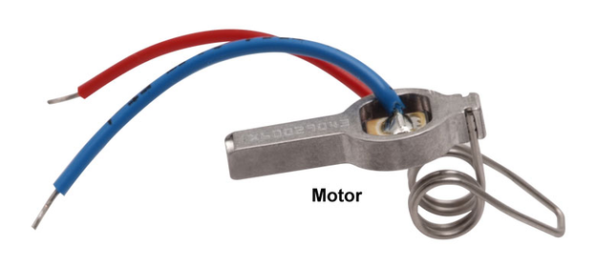
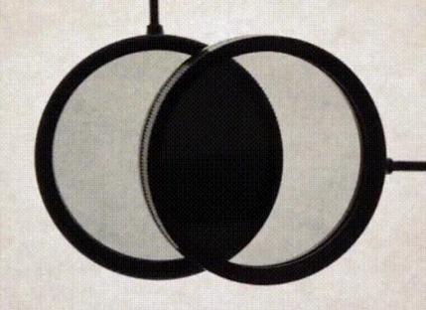


UNIQUENESS
PIEZOELECTRIC MOTOR
Ultrasonic voltage signal drives piezoelectric chip, vibrating aluminum
housing, pushing motor tip for resonance-driven rotation.
POLARIZATION FILTER
Polarization filters are designed to selectively transmit light oscillating in a particular direction while blocking light oscillating in other directions.
FEASIBILITY
Feasibility to adapt with all other lower-end vehicles varies and depends on the specific vehicle and the intended adaptation.

Slide 7







CUSTOMER SEGMENTS
NIGHT TIME DRIVERS
AWARENESS THROUGH GOVERNMENT
AND MUNICIPAL PARTNERSHIPS
COMMUTERS
LONG DISTANCE TRAVELERS
INFLUENCER MARKETING /
COLLABORATIONS AND PARTNERSHIPS
WITH AUTOMOBILE COMPANIES
COMMERCIAL DRIVERS/
TRAVEL AGENCIES

Slide 8

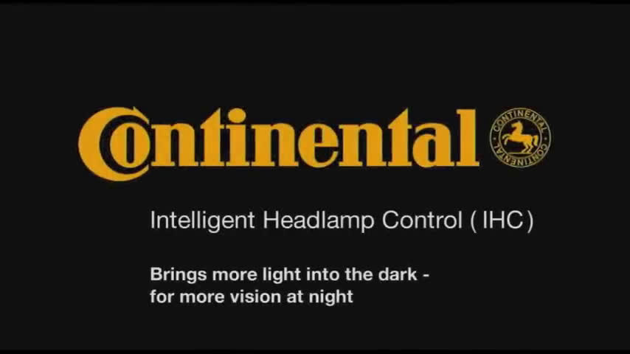
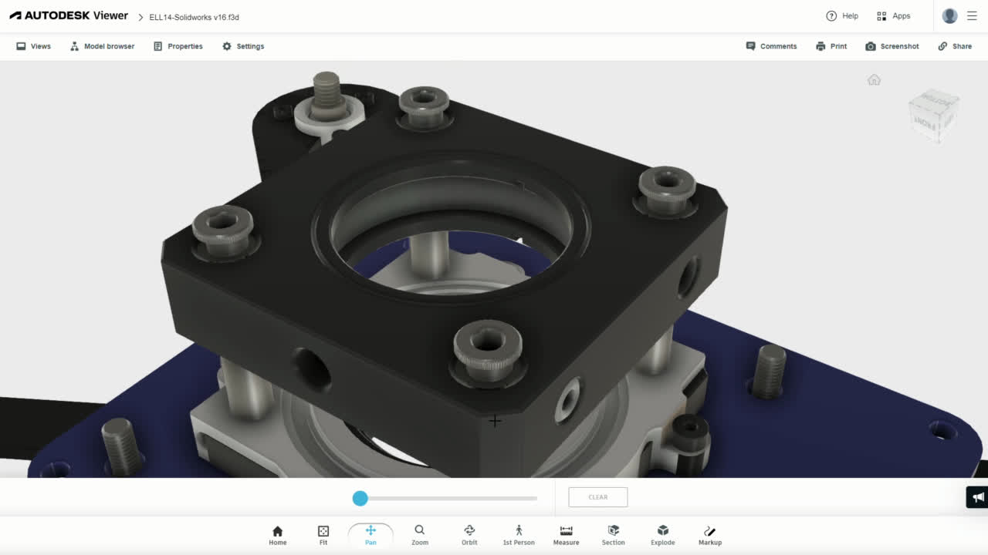

REAL TIME MODEL
PROTOTYPE MODEL

Slide 9


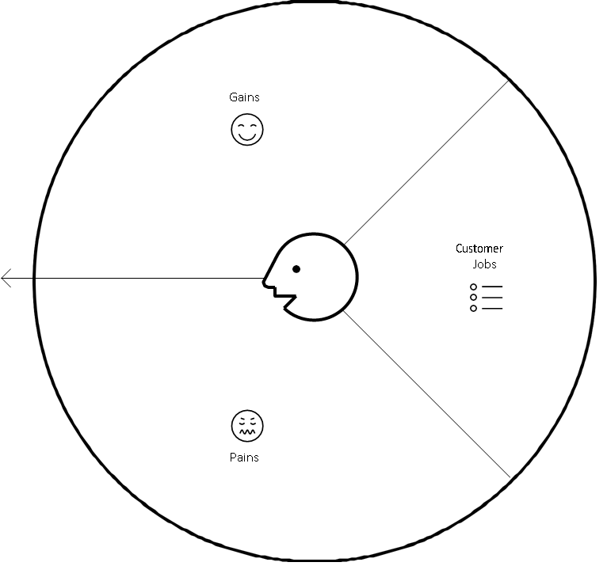
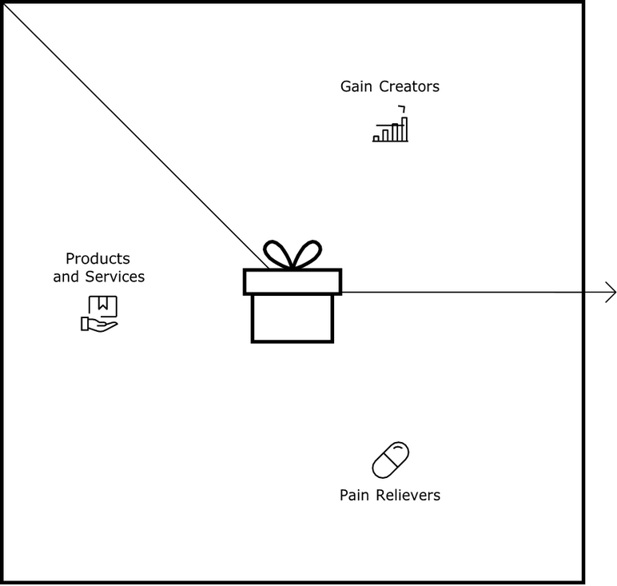









VALUE PROPOSITION MODEL
Increases confidence level for commuters
Affordable for commoners
Decreases anxiety for nighttime travellers
Avoids glare from on-coming headlights
FIT
CUSTOMIZED FIT
INTEGRATION WITH EXISTING SYSTEM
Feel safer to drive
Ease of installation
Reduces stress fatique
Better concentration
Customers find it challenging to adapt

Slide 10
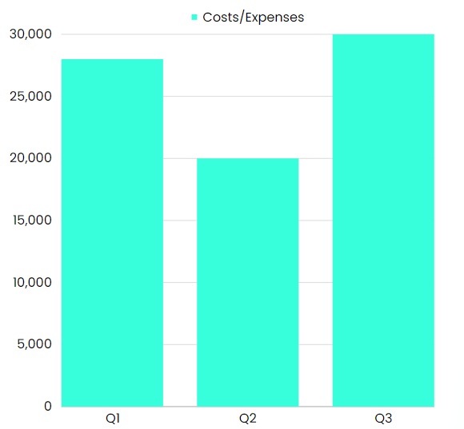


COST STRUCTURE
Q1- COMPONENTS COST:
The components list consists of a Polarizer filter, piezoelectric Motor Cost, Lidar technology, and some needed consumables.
Q2- Manufacturing Cost:
The Manufacturing cost includes the process of casting, assembling, mechanical parts, etc.,
Q3- Final Testing & Marketing :
The final testing includes higher-end equipment.
The marketing of the designed product will be marketed to the customers by multimedia, awareness, etc.
TOTAL COST:
Total = 78,000

Slide 11

Product Roadmap
STAGES
1st Quarter
(Dec-Feb)
2nd Quarter
(Mar-May)
3rd Quarter
(Jun-Aug)
4th Quarter
(Sep-Nov)
INITIATION STAGE
PROJECT INITIATION
AND PLANNING
DESIGN AND PROTOTYPING
PLANNING STAGE
DEVELOPMENT
TESTING
Finalize Materials
OFFERING AND GETTING
CLIENT CONSENT
EXECUTION STAGE
MANUFACTURING

Slide 12
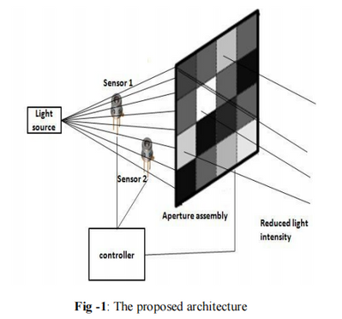
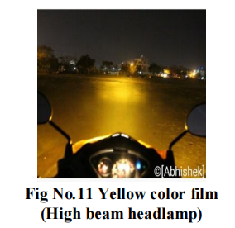
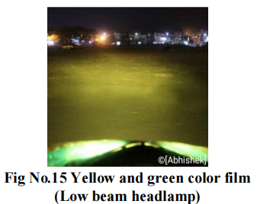
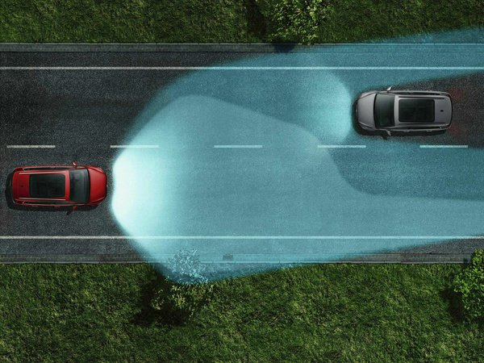

REFERENCES & EXISTING ALTERNATE
1
2
3
Shrinivas S. Metan, Abhishek R. Kshirsagar, Govind N. Samleti, Vinayak K Patki, “ANTI-CLARE HEADLAMP A SAFE OPTION FOR BETTER VISION TO THE RIDER”, IJITEE, Vol-08, Issue-9S2,July-2019
Anupama V, Divya Pankaj , Gayathri Anand , Soman K P,”AUTOMATIC ANTI-GLARE SYSTEM FOR NIGHT TIME DRIVING USING LIQUID CRYSTAL SCREENS”,IJRET,Vol-03,Issue-01,Jan-2014
Volkswagen Company high-end Cars
The dynamic main-beam control Dynamic Light Assist improves visibility at night.
The system can detect oncoming vehicles and vehicles ahead and automatically mask the corresponding areas of your main beam headlights.

